Slide 1
Aim: How can we find the robot through wireless communication?
Do now: ( 3 mins)
Write down at least 3 wireless communication devices that you use everyday.
Notes:
‹#›
Upon successful completion of this chapter, you should be able to:
Understand the underlying technical concepts for voice transmission, voice digitization, voice compression, and data/voice integration.
Understand currently available voice-related technology including PBXs, Voice Digitizers, and Voice/Data Multiplexers and Modems.
Understand the functionality, standards, business impact, and technology involved with computer telephony integration.
Understand the functionality, concepts, standards, business impact, and technology involved with voice networks services, voice transmission alternatives, and voice/data integration.
Network Analysts must be qualified to design networks that are capable of carrying voice as well as data.
Before assigning such networks, it is essential for the network analyst to understand the nature of voice signals, as well as how voice signals can be processed and integrated into a cohesive network with data transmissions.
Voice communication used to be exclusively analog transmissions but is becoming more digital.
Once a voice signal has been digitized, a wide variety of transmission services can potentially be employed to complete the transmission of the voice signal to its designated destination.
In some cases voice transmissions can be integrated with data transmission.
Standards play an essential role in ensuring end-to-end interoperability.
This chapter covers these concepts:
Voice Digitization and Compression (Voice Transmission Basic Concepts)
PBX – Private Branch Exchange – now seen as a Voice Server, a server like any other.
Voice and Data Convergence technologies

Slide 2
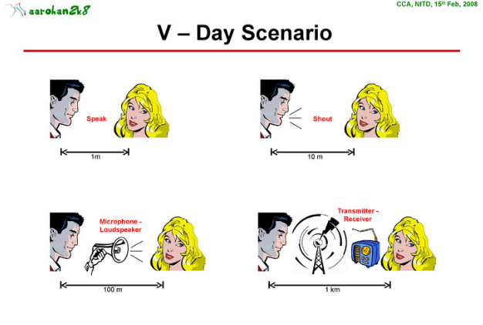
History of Walkie- Talkie

Slide 3
History of Walkie-Talkie
A walkie-talkie is a hand-held, portable, bi-directional radio transceiver.
the name walkie-talkie was said to have been coined in 1941 during a demonstration in Toronto. A reporter saw a soldier walking about the c-18 version strapped to his uniform. “what does it do?” the soldier was asked.
“Well, you can talk with it while you walk with it” was the answer and the name of walkie-talkie was born.

Slide 4
History of Walkie-Talkie
When walkie-talkie first invented, someone needed to carry part of the walkie-talkie on their back because it was so large. It is not clear who should get credit for the invention of the device.
Around the same time Al Gross was walking on his model, Donald Hings was working on his version of the walkie walkie which he called a “packset”. Hings invention was used during War World Two starting in 1942 and was very important in the war effort.

Slide 5
History of Walkie-Talkie
After World War Two the use of the band held radio spread throughout different public sectors. With more compact designed police and fireman began to reply more on the device for communication. Later walkie-talkie use move for public to private sectors and to everyday use for the average person or even toys for children.

Slide 6
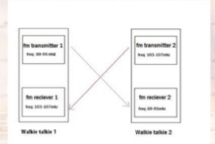
How to Work?
The walkie-talkie communication system consists of two receivers and two transmitter circuits. One receiver and one transmitter circuits are for each walkie- talkies. The general structure of the system looks like this:

Slide 7
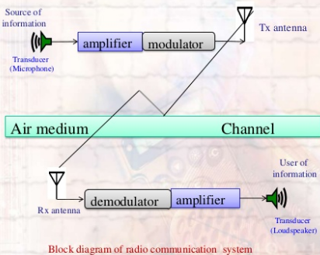
How to Work?
Amplifier- An electronic device for increasing the amplitude of electrical signal, used chiefly in sound reproduction.
Modulator- a device that modulating a carrier wave
Demodulator- an electronic circuit that is used to recover the information content from the modulated carrier wave.
Notes:
‹#›
Digital Cross-Connect
A network device used by telecom carriers and large enterprises to switch and multiplex low-speed voice and data signals onto high-speed lines and vice versa. It is typically used to aggregate several T1 lines into a higher-speed electrical or optical line as well as to distributed signals to various destinations; for example, voice and data traffic may arrive at the cross-connect on the same facility, but be destined for different carriers. Voice traffic would be transmitted out one port, while data traffic goes out another.
Digital cross-connect Systems (DCSs) are widely used in conjunction with central office telephone switches and may be installed both before and/or after the switch. Cross-connections are established via an administrative process and are semi-permanent, whereas the telephone switch dynamically picks up dialing instructions and routes calls based on telephone number.
Cross-connects come large and small handling only a few ports up to a couple of thousand. Narrowband, wideband and broadband cross-connects support channels down to DS0, DS1 and DS3 respectively

Slide 8
How to Work?
a transducer is a device that converts a signal in one form of energy to another form of energy. Microphone and loudspeaker are the transducers.
after the sound is converted to the electrical signal, amplifier amplifiers it in the transmitter circuit. Modulation is the carrying of the message signal with the carrier signal, Modulator makes this duty.
in the receiver circuit, demodulator separates the message signal from modulated signal and amplifier increases the message signal to be heard easily. Loudspeaker converts the electrical signal to the sound.
Transducer and receiver must be in the same frequency interval to communicate each other.

Slide 9
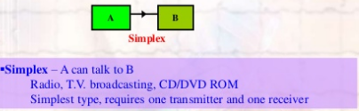
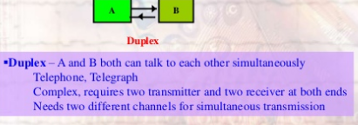
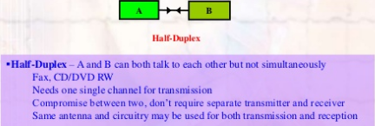
Types of Communication
A Transceiver is a small unit that combines a transmitter and a receiver.
a small hand-held unit of transceiver is popular called a walkie-talkie.
the usual controls on the small transceivers unit are off-on switch with volume control, push-to -talk button, sqelch control (eliminate background noise) and jack for earphones.
Notes:
‹#›
System Signaling
In addition to voice signals, the telephone system must also carry information about the call itself. This system is referred to as: System Signaling or Interoffice Signaling
At minimum System Signaling, provides Call setup and Call termination.
Adv. Functions: Call Waiting, Caller ID, 3-Way Calling
Two methods to System Signaling: In-Band and Out-of-Band.
In-Band: signals are sent on the same channel as the voice data itself. It’s used to send system signals across the analog local loop for most home telephones.
When you pick up the phone the CO switch acknowledges that the circuit is open and ready for transmission by providing a dial tone. You dial, sending the phone number across the voice bandwidth, and listen for the phone to ring. If the called party answers the phone, the remote telephone switch comes off the hook and the connection is established.
Destination phone number can be communicated to phone switch in 2 ways:
Pulse Dialing pulse of electricity are generated (rotary phone). Modern phone switches no longer use mechanical relays.
Tone Dialing or DTMF (Dual Tone MultiFrequency). These tonescan also enable special servies on PBXs, carriers, banks, information services, and retail establishments.
When you terminate the call, hang up or change status from off-hook to on-hook (flash button), the telephone switch knows you are ready to receive a call. Call waiting, three-way calling, and caller ID all use similar in-band means to communicate between the phone handset and the local phone switch.

Slide 10
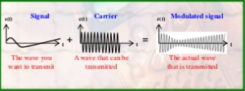
What is the modulation?
Modulation is the process of superimposing a signal (message signal) on a high frequency signal (carrier signal) to transmit easily.

Slide 11
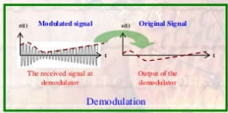
What is the demodulation?
Demodulation is the opposite of the modulation. Demodulation is used in receiver. When the modulated signal is come into the receiver, the demodulator separate the message signal from the modulated signal.
Notes:
‹#›
Although in-band signaling works well for communication between the phone handset and the local phone switch across the analog local loop, the inter-switch connections on the digital PSTN make use of a separate channel to carry the system signaling data. Out-of-Band Signaling provides a means to manage the network itself by handling the routing of calls and circuit establishment as well as monitoring circuit status and notification re-routing in the case of alarms or circuit problems. By moving the call setup and management data to a separate network, it becomes easier to support transparent operation between different digital encoding mechanisms. The management data is readily available to each piece of the telephone network equipment regardless of the encoding mechanism used.
Signaling System 7
CCITT-approved standard for out-of-band signaling.
Uses a packet switched network physically separate from the circuit switched network.
Each node on the PSTN must connect to both the voice network and the SS7 network.
Like most protocol suites SS7 can modeled to the 7-layer OSI model.
SS7 and the intelligent services it enables are often described as part of an all-encompassing interface between user and the PSTN know as the AIN (Advanced Intelligent Network) or IN (Intelligent Network).
Services enabled by AIN include:
Alternate billing service (ABS) This service allows a long-distance call to be billed to a calling card, third party, or receiver (collect call).
CLASS (Custom Local Area Signaling Service) A group of services local to the customer's telephone. Examples include call waiting, call forwarding, call blocking, caller ID blocking, busy number redial, and automatic redial of missed calls.
Enhanced 800 service This service allows 800 number portability. Originally 800 numbers were tied to specific area code and long distance provider. This service resolves those limitations.
ICP (Intelligent Call Processing) Using this service customers are able to re-route incoming 800 calls among multiple customer service centers in a matter of seconds. This re-routing is done completely transparent to the calling customer. ICP allows multiple call centers geographically dispersed throughout the country to function as one logical call center, with the overall number of incoming calls distributed in a balanced manner across all centers.
User oriented network services such as AIN are being offered in response to user demands for in-house control over a key element of their business: their telecommunications systems and the links from those systems to the wide area PSTN. Catalog sales organizations for example.

Slide 12
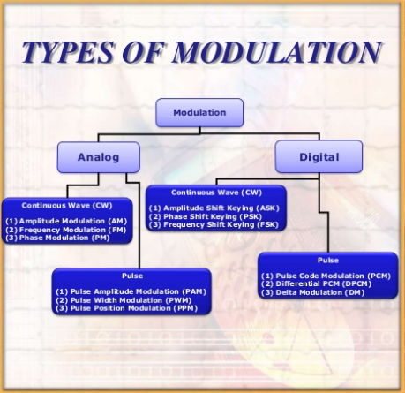

Slide 13
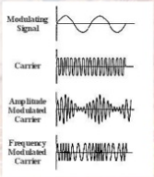
AM vs FM
In amplitude modulation (AM), the message signal is impressed on the amplitude of th carrier signal. Modulation is done with changing amplitude of carrier signal.
In frequency modulation (FM), the frequency of the carrier is changed according to the variation in the message signal.
Notes:
‹#›
Voice Digitization
The analog POTS system has largely been supplanted in the modern telephone system by a combination of analog and digital transmission technologies. Although analog is effective, it is limited in terms of quality, distance, and capacity. The longer the signal has to travel, the poorer the quality. Also significant capacity issues are associated with analog transmission. In general the only one voice conversation can be carried on a single set of wires using analog transmission.
Most voice digitization techniques employ a sampling rate of 8000 samples per second.
Pulse Amplitude Modulation (PAM), like AM radio it varies the Amplitude or voltage of the electrical pulses in relation to the varying characteristics of the voice signal. PAM was the voice digitization technique used in some earlier PBXs.
Pulse Duration Modulation (PDM), like FM radio and also known as Pulse Width Modulation (PWM), varies the duration of each electrical pulse in relation to the variances in the analog signal.
Pulse Position Modulation (PPM) varies the duration between pulses in relation to the variances in the analog signal. By varying the spaces in between the discrete electrical pulses on the digital circuit, PPM focuses on the relative position of the pulses to one another as a means of representing the continuously varying analog signal.

Slide 14
Advantages
AM | FM
It is simple to implement It can be demodulated using a circuit consisting of very few components AM receivers are very cheap as no specialized components are needed. | AM is more affected by static or noise than F< Unwanted electromagnetic waves do not cause the frequency of FM carrier wave to change Resilient to signal strength variations Does not require linear amplifiers in the transmitter enables greater efficiency than many Other modes.
In conclusion FM is more preferred than the AM in walkie-talkies.

Slide 15
When the walkie-talkie comes close to another signal transmitter on the same channel frequency. It will cause a signal interference so all you can hear from your walkie-talkie is the undefined noise. In this lesson, we will use this property to locate the robot.

Slide 16
Pick your group!
Group # | Role | Duties
1 | Hide the Robot | You will have 5 mins to hide the robot with the mobile node. you can not turn down the signal at any point. After the game start, you can not touch the robot anymore but you can still control your robot to move. do not make any noise during the activity. Do not run in the hallway
group 2,3,4,5 | Find the Robot | each group will hold a walkie-talkie try to find the robot. you can not communicate across group. you can not ask other people for help. you have 30 mins to find the robot.

Slide 17
Exit Slip
Write a plan on how your group plan to hide or find the robot in detail, you only approved to play the game if your plan is approved.
You plan should be around 300-500 words.

