Slide 1
CO₂ vs. Plant Density Lab
Ms. Shahid Living Environment

Slide 2
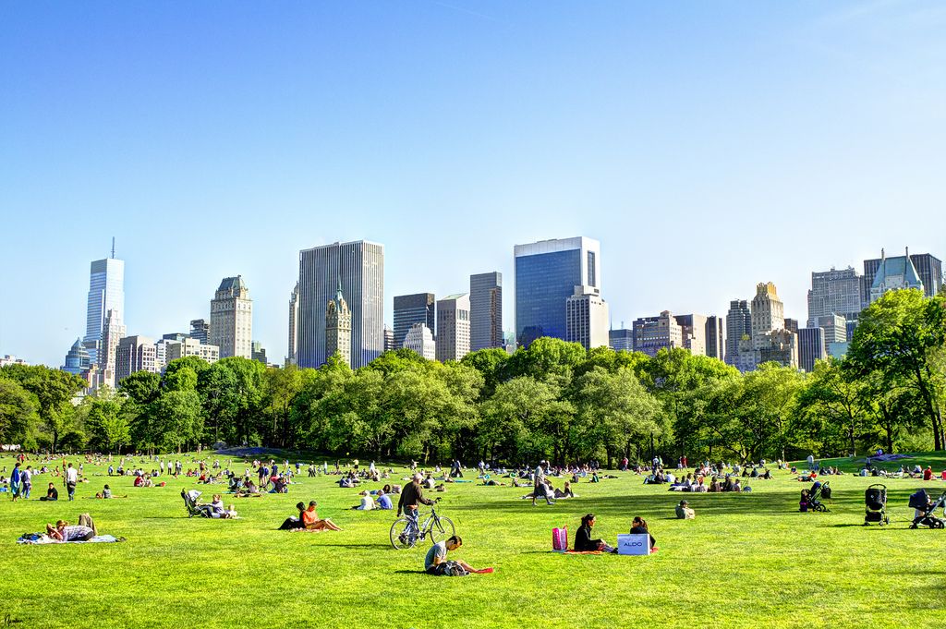

Do Now (5 mins) - Turn and Talk!
Write down your partner’s responses to the following questions. Be ready to share what they said!
Based on your knowledge of photosynthesis, what changes would a highly photosynthesizing plant cause to its environment? (Try to recall the formula)
Do you think the air in Central Park would have the same composition/properties as the air by FDR Drive? Explain your reasoning.
Bonus! The atmospheric CO2 concentration is predicted to double within our lifetime. How do you think this will impact the distribution of plant species throughout the world?

Slide 3
Agenda
Day one
Do Now
Introduction to lab
Lab design in groups
Day two
Do Now
Introduction to devices used
Setup of lab apparatus

Slide 4
Objective of Lab: Design a lab to look at how CO₂ levels change with varying plant densities
Groups of 4
Four weeks - first two weeks → measure CO₂ with no plants
First day of week 3 -- transfer your plant of choice
You design the rest of the lab in your groups! (30 min)
  Use the provided template
  Make sure I initial your checkboxes in each section before you move on
  Make sure you identify as many constants as possible (Why?)
  Identify your independent variable: What species of plant? size? number? (research as needed)

Slide 5
(Add pic of lab setup here)

Slide 6
Second period

Slide 7
Do Now - Take out lab notebooks and discuss:
Discuss and jot down notes (5 min)
Explain what variables are being changed in your experiment, and your reasoning. What do you expect to happen due to the independent variable you chose?

Slide 8
Introduction of Device Used
(not sure what goes here yet)
If Arduino, show how the sensor works with a video and demo
Same for Vernier, but need to show how to insert parts into tank
Show how to set up apparatus using a student to model

Slide 9
Set up lab apparatus (10-15 min)
Keep in mind that you will have a plant in there in 2 weeks! Think about what it will need and note these in your lab notebook
You will be monitoring your experiment once a week. What are you going to take note of?

Slide 10
During Data Collection

Slide 11


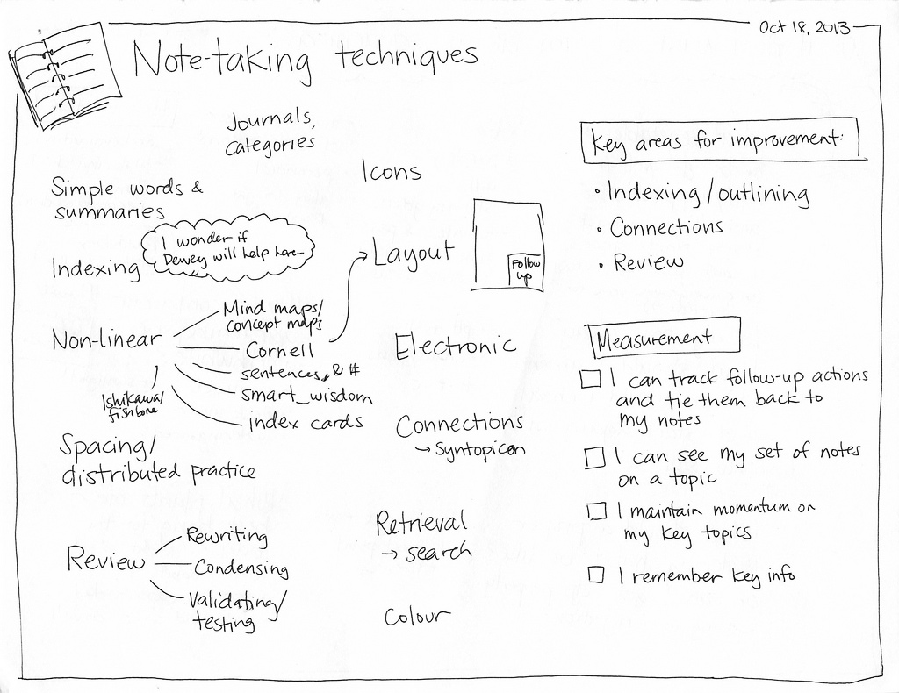
Record changes in your experiment!
(5 mins) - In lab notebooks, every Friday
Date of your observations (how many days has it been?
Look at your notes from last time -- what are you taking note of?
Make sure that all group members are taking their own notes, while also discussing each other’s points and adding on.

Slide 12
Post-data collection

Slide 13
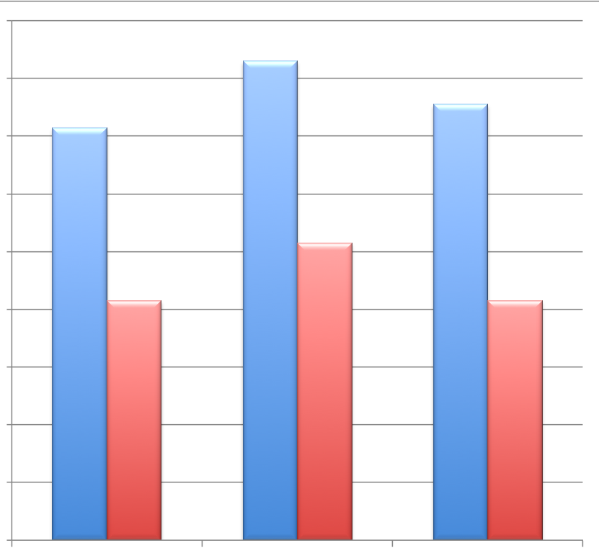

Gallery Walk (20 min)
Group Discuss (5 min)
Post up your lab experimental data
Compare your findings
  In your lab notebooks - take note of other groups’ experiments and how their setup and results were similar to or different from your group.
Discuss as a group your findings and decide which group’s results you found to be the most “interesting”. Be ready to share to the whole class at the end of the five minutes.

Slide 14
Extensions to your experiment?
HW
Think about other factors that may be tested for as we did in this experiment
Think about the equipment we used

