Slide 1








Slide 2
Unit 5: Evolution of Technology in Science
Topic: Bandwidth and Data Rate
Learning Target: I can…
Understand what signal bandwidth is.
Understand how bandwidth affects the rate with which we transmit information.
Standard(s):
MS-PS4-3. Integrate qualitative scientific and technical information to support the claim that digitized signals are a more reliable way to encode and transmit information than analog signals.

Slide 3
Homework
Research and write a short paragraph to explain what transmission data rate is.
Problem of the Day
What do you think makes your internet slow?

Slide 4
Discussion Questions
What is bandwidth?
Why is bandwidth important in transmitting information?

Slide 5
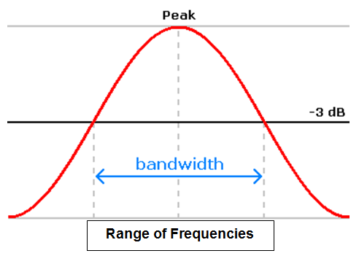
Bandwidth
Bandwidth is the range of frequencies “occupied” by a signal – in particular, the width of the range of frequencies.

Slide 6
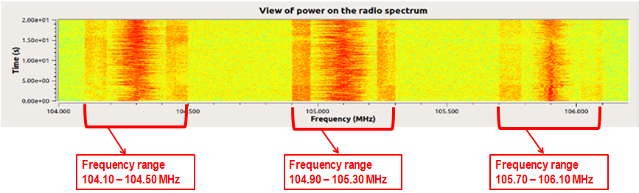
Bandwidth
Recall, that when looking at a signal in the frequency domain, we saw that the signal may not be only confined in a narrow range of frequencies, but may have energy on a wider set of frequencies. See below:

Slide 7
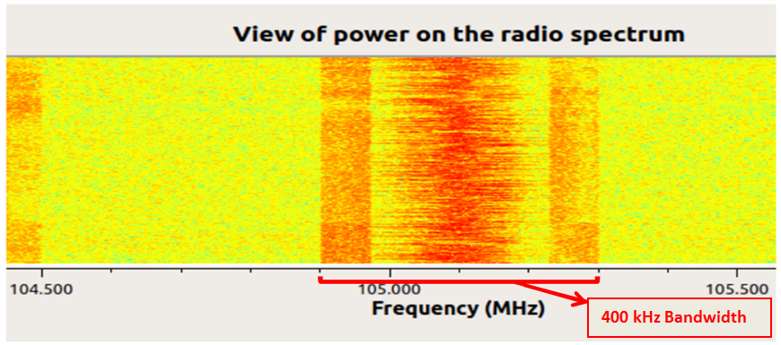
Bandwidth
Let us take a closer look at the graph showing the “Power of the radio spectrum”
Each “point” on the frequency axis is 100 kHz. We can see that this signal occupies 400 kHz in total. This is its bandwidth.

Slide 8

Bandwidth
Think of bandwidth as a garden hose we use to water our flower garden. The greater the diameter of the garden hose, the greater amount of water the garden hose can carry. Similarly, the flow of information data is affected by its bandwidth. The greater the bandwidth, the faster we can send data and the more data we can send.

Slide 9
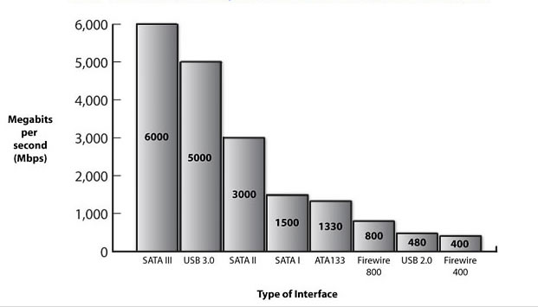
Data Rate
Data rate is how much information we can send over the air in a given amount of time. It is usually measured in bits per second, (a bit is a 0 or 1 value) meaning how many bits can be transmitted within a single second.

Slide 10
Bandwidth & Data Rate
The relationship between data rate and bandwidth is defined as follows: if all other factors are kept constant, the rate at which we can send data on an electromagnetic wave is proportional to the bandwidth it occupies. In other words, if we double the signal bandwidth, the rate at which this signal can carry information will also be doubled!

Slide 11

Lab Activity
We are now going to perform an experiment/activity in which you will send a specific amounts of data at 2 different data rates and measure the bandwidth and the time it took to transmit the data. We will then compare and contrast the bandwidths and the transfer times to see the relationship between the two. We will use equipment from our COSMOS Technology Toolkit: a computer and monitor, an ADALM-PLUTO Transceiver and antenna. This experiment can also be done on the WITEST, ORBIT, or COSMOS testbed.
The materials are already assembled on your desks. Get ready and wait for your teacher to tell you to begin

