Slide 1








Slide 2
Unit 5: Evolution of Technology in Science
Topic: Digital Wave Signals
Learning Target: I can…
Perform an activity to demonstrate the difference between digital AM transmissions and digital FM transmissions
Standard(s):
MS-PS4-3. Integrate qualitative scientific and technical information to support the claim that digitized signals are a more reliable way to encode and transmit information than analog signals.

Slide 3
Homework
Research and write a short essay to explain how wireless technology works
Problem of the Day
State 5 devices that use digital signals

Slide 4
Discussion Questions
Why do you think it is so easy to steal digital signals?

Slide 5
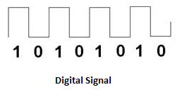
Digital Signals
Digital signals are represented by specific values over time. Signals are in binary form (i.e. ‘0’ or ‘1’). The transmissions of digital signals are a lot less affected by noise compared to analog. That is why digital signals usually sound very clear and cleaner than analog signals. Digital signals require larger bandwidth than analog. Computers can only interpret and understand digital signals.

Slide 6
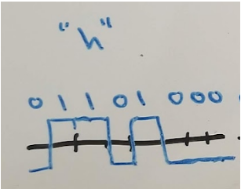
Digital Signals
Here is an example of how computers understand the information we inter into them. When we type a message and send it each letter is represented in binary form. For example, the letter “h” is modulated into “01101000”. When the message is received by the receiver all the binary numbers making up the message are demodulated back into the letters that made up our original message.

Slide 7
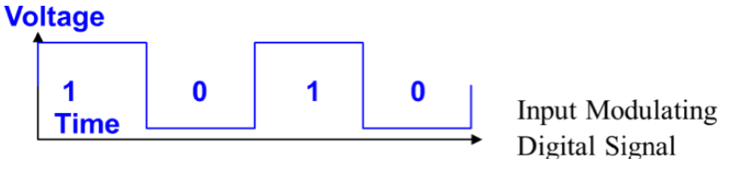
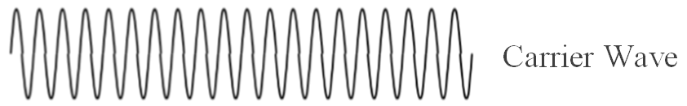
Digital Signals and AM
A computer can only process digital data, where all the information is in bit-streams of 1’s and 0’s (or, high voltage when the data is 1, and low voltage when the data is 0.) So a digital information signal would look something like this:
This information signal has to be carried on a carrier wave with a higher frequency like this:

Slide 8
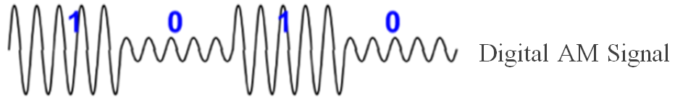
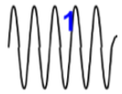

Digital Signals and AM
To carry the digital signal using amplitude modulation (AM), we will vary only the amplitude of the carrier wave according to the value of the information signal. So the digital AM signal that is transmitted looks like this:
The shape of the digital AM signal can be represented as symbols, where: represents 1, and represents 0.
The computer can now interpret and understand the digital signals.

Slide 9
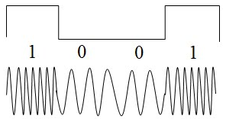
Digital Signals and FM
In Frequency Modulation (FM) of a digital signal, we expect the signal to change only its frequency according to the information signal. Therefore, when the information signal has a “1” value, the frequency of the FM modulated signal will be a bit higher than the carrier frequency, and when the information signal has a “0” value the frequency of the FM modulated signal will be a bit lower than the carrier frequency.

Slide 10
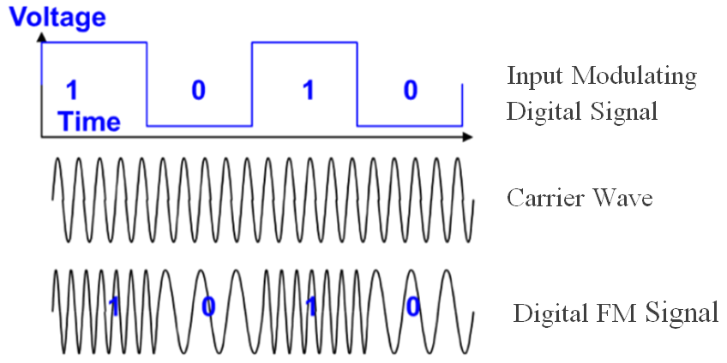
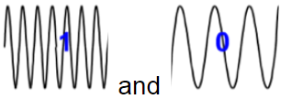
Digital Signals and FM
So, when we carry and transmit digital information signals using frequency modulation it would look something like this:
The shape of the digital FM signal can be represented as symbols, where: represent 1 and 0 respectively.
Here again the computer can now interpret and understand the digital signals.

Slide 11

Lab Activity
We are now going to perform an experiment/activity in which you will observe digital signals in AM and digital signals in FM and compare and contrast their characteristics. We will use equipment from our COSMOS Technology Toolkit: a computer and monitor, an ADALM-PLUTO Transceiver and antenna.
The materials are already assembled on your desks. Get ready and wait for your teacher to tell you to begin

