Slide 1








Slide 2
Unit 3: Structures of Life
Topic: How Does Physical Activity affect the Pulse
Rate
Learning Target: I can…
Perform an activity to show how physical activity affects the pulse rate
Standard(s):
MS-LS1-3. Construct an explanation supported by evidence for how the body is composed of interacting systems consisting of cells, tissues, and organs working together to maintain homeostasis.

Slide 3
Homework
Write 1 paragraph to explain how long can a person survive after his heart stops beating?
Problem of the Day
How would your heart rate would change if your grandma passed away vs. if you won the lotto.

Slide 4
Discussion Questions
Is your heart rate and your pulse rate the same thing
Where on your body can you feel your pulse rate
Turn to p. in text

Slide 5
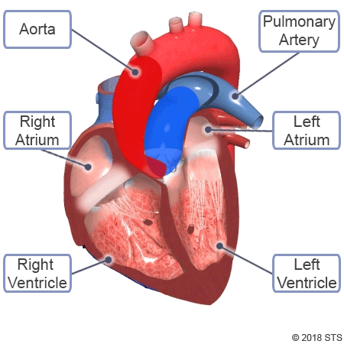
The Heart
The heart is in the middle of your chest but slightly tilted to the left. It is divided into a right & left side with 4 chambers. There are 2 upper and 2 lower chambers. The 2 upper chambers are called the right & left atriums and the 2 lower chambers are called the right & left ventricles.

Slide 6
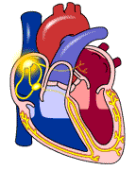
The Heart is a Pump
The heart is a pumping organ. Blood is forced through the arteries as the heart muscles contract and relaxes. This creates a series of waves in the blood as it flows through the arteries. These waves are called the pulse. Your pulse rate is the number of times your heart beats in one minute.

Slide 7
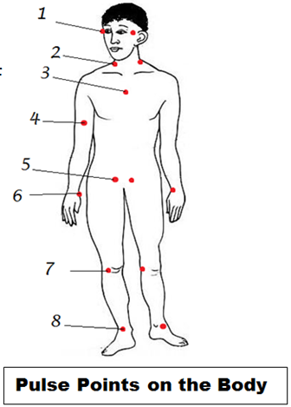
Pulse
Your pulse can be felt reasonably well at 7 points on your body (including the center of your chest). They are:
your temples (upper sides of your head),
the sides of your neck,
the center of your chest,
the inside of your upper arms,
the upper part of your legs at your groin,
your wrists,
the back of your knees, and
at the sides of your foot near your ankle.

Slide 8
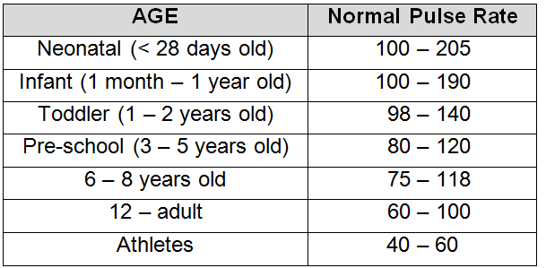
Pulse Rate
Normal pulse rate varies from person to person but a normal range for adults is 60 – 100 beats per minute. A person’s pulse rate depends on several factors like the individual’s age, body size, heart condition, medical drug use, if the person is sitting or moving, how fit they are, and even the air temperature.

Slide 9
Pulse Rate of Athletes
Athletes who engage in regular physical activity can have their heart become more efficient and thus reduce their heart rate (pulse rate). This will allow these athletes to engage in physical activity for longer periods of time.

Slide 10

Lab Activity
We are now going to perform an activity/experiment in which we will observe how physical activity affects the pulse rate. We will use the COSMOS Technology Toolkit, a heart rate sensor and a timer for this activity.
The materials are already assembled on your desks. Get ready and wait for your teacher to tell you to begin

