Slide 1
Do Now
Imagine you could broadcast a sound signal as EM waves, and visualize them like we saw waves on the computer screen yesterday.
What would the representation of sound waves for a clap look like?
A whistle?
After talking to your team, draw what you think the waves for #1 and #2 would look like in your notebook.
TOC: AM & FM Part 2

Slide 2
Review
What is amplitude?
What is frequency?
What is modulation?

Slide 3

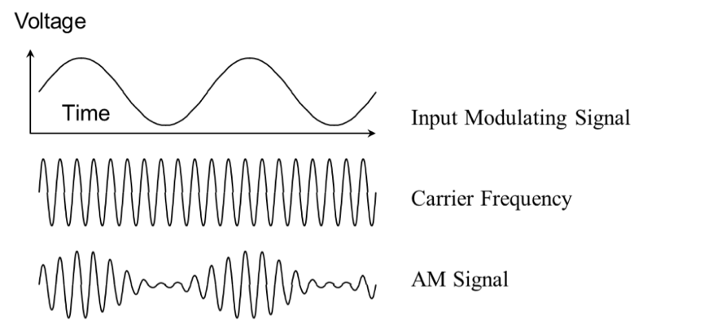
In amplitude modulation (AM) you vary the amplitude of the wave.

Slide 4
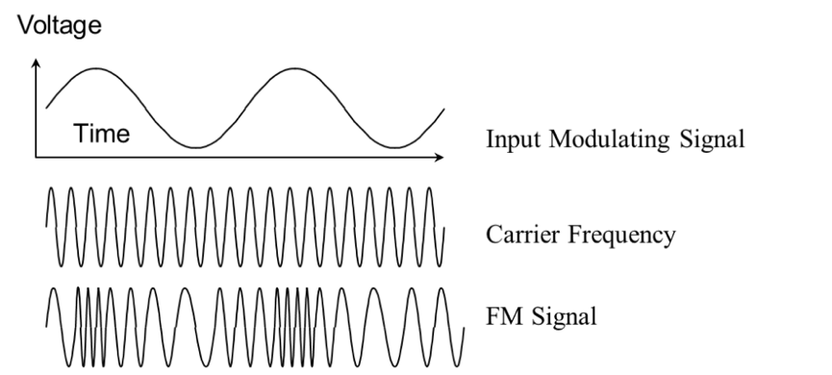
In frequency modulation (FM) you vary the frequency of the wave.

Slide 5
Lab Activity
Today we will generate voice signals
So we can observe how different types of signals produce distinct AM and FM waves
I’ve got it when I can draw conclusions about AM and FM from my observations of voice signals.
Materials:
COSMOS Technology Toolkit
  Computer and Monitor
  ADALM-Pluto SDR Active Learning Module
  Antennae
Procedure:
See your packet

Slide 6
Roles
Leaders - read directions to the group & keeps group members on track
Tech managers - operate the computer, take & upload screenshots of data to Google Classroom
Captioneers - describe the uploaded screenshots with a 1-2 sentence caption
Noisemakers - produce the sound signals (speech, claps, etc.)
Scribes - record data in the packet & make sure all other group members ALSO record data

Slide 7
Exit Ticket
3 things you learned about AM, FM, and voice signals
2 things you noticed about AM, FM, and voice signals
1 question you still have about AM, FM, and voice signals

Slide 8
Homework
Complete the question at the bottom of p. 4.
What conclusions can you draw from your observations of an AM voice signal and an FM voice signal?
(Note: You can view your group’s screenshots by going to the Google Classroom website on your computer or app on your phone.)

